Slide 1
AERODYNAMICS
د. محمد خضير عباس

Slide 2
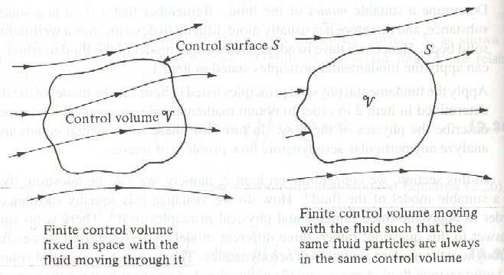
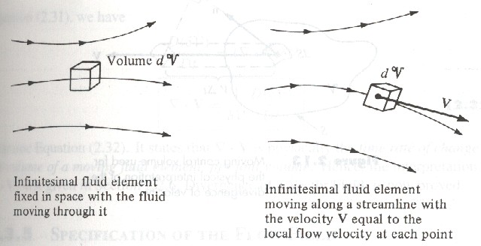
Control volumes and fluid elements
Control volume approach
Fluid element approach

Slide 3
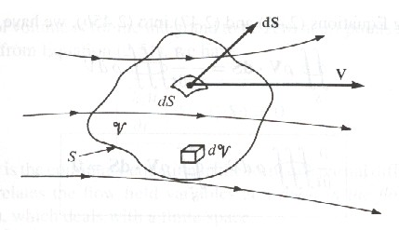
Continuity equation
Fixed control volume
Mass flow equation
Continuity equation in a finite space
Continuity equation at a point

Slide 4
Momentum equation
Fixed control volume
Original form is Newton’s second law
Momentum equation in integral form
f is body force; Fviscous is viscous force on control surface
X-component of the momentum equation in differential form (similar form for y- and z-component).

Slide 5
Navier-Stokes equations
The momentum equations for a viscous flow.
Euler equations
The momentum equations for a steady inviscid flow.

Slide 6
Pathlines and streamlines
Pathline
Path of a fluid element.
Streamline
A curve whose tangent at any point is in the direction of the velocity vector at that point.
For steady flow, pathlines and streamlines are identical.

Slide 7
Streamline equation for steady flow
By definition, flow velocity V is parallel to directed segment of the streamline ds, so dsxV=0
For two-dimensional flow

Slide 8
Angular velocity, vorticity and circulation
Angular velocity and vorticity
As a fluid element translate along a streamline, it may rotate as well as shape distorted.
Angular velocity ω
Vorticity ξ is defined to be 2ω, also equal to ∇xV.
If ∇xV≠0, the flow is rotational, and ω≠0.
If ∇xV=0, the flow is irrotational, and ω=0.

Slide 9
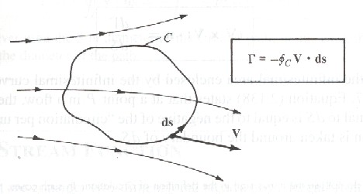
Circulation Γ
Definition
Relation with lift: if an airfoil is generating lift, the circulation taken around a closed curve enclosing the airfoil will be finite.
By Stokes’ theorem

Slide 10
If the flow is irrotational (∇xV=0) everywhere with the contour of integration, then Γ= 0.

Slide 11
Stream function and velocity potential
Stream function
For two-dimensional steady flow, a streamline equation is given by setting the stream function equal to a contant.
For incompressible flow

Slide 12
Velocity potential
For an irrotational flow
We can find a scalar function φ such that V is given by the gradient of φ which is therefore called velocity potential.

Slide 13
Relation between ψ and φ
Equipotential lines (φ= constant) and streamlines (ψ = constant) are mutually prependicular.

Slide 14
Elliptical lift distribution
Charateristic
Elliptical circulation distribution
where Γ0 is the circulation at the origin.
Elliptical lift distribution
Zero lift at the wing tips

Slide 15
Resulting aerodynamic properties
By using the transformation y=b/2 cosθ, we obtain
which states that downwash is constant over the span for an elliptical lift distribution.
Induced angle of attack

Slide 16
Induced drag coefficient
which states that CD,I is proportional to the square of CL and inversely proportional to AR.
For an elliptical lift distribution, the chord must vary elliptically along the span; that is, the wing planform is elliptical.

Slide 17
General lift distribution
Characteristic
Consider the transformation
and assume
Fundamental equation at a given location

Slide 18
We may choose N different spanwise stations, then we can obtain N independent algebraic equations with N unknowns, namely, A1, A2, …AN.
Resulting aerodynamic properties
Lifting coefficient
Induced drag coefficient

Slide 19
Define span efficiency factor e
Note that δ=0 and e=1 for the elliptical lift distribution. Hence, the lift distribution which yields minimum induced drag is the elliptical lift distribution.

